Slide 1
2021 Annual Report
March 30, 2022
Presented to: Troy Community Land Bank Board of Directors
Presented by: Anthony Tozzi, Executive Director

Slide 2
Overview of 2021 Annual Report
Mission Statement, Goals & Target Area
Board of Directors, Committee Members and Activities
2021 Highlights and Challenges
2022 Goals and New Initiatives
Closing Remarks

Slide 3
Mission Statement
The Troy Community Land Bank’s (“TCLB”) core purpose is to acquire and redevelop vacant, abandoned and under-utilized properties through community partnerships and strategic planning. Our overall goal is to encourage economic growth, long term sustainability and new opportunities for all of Troy’s residents and businesses so that together we can build stronger neighborhoods and enjoy greater quality of life. The TCLB has strategically identified areas of the city where it focuses its efforts for demolition, stabilization and rehabilitation activities.
Partners in our Mission
3229 6th Ave stabilization in progress

Slide 4
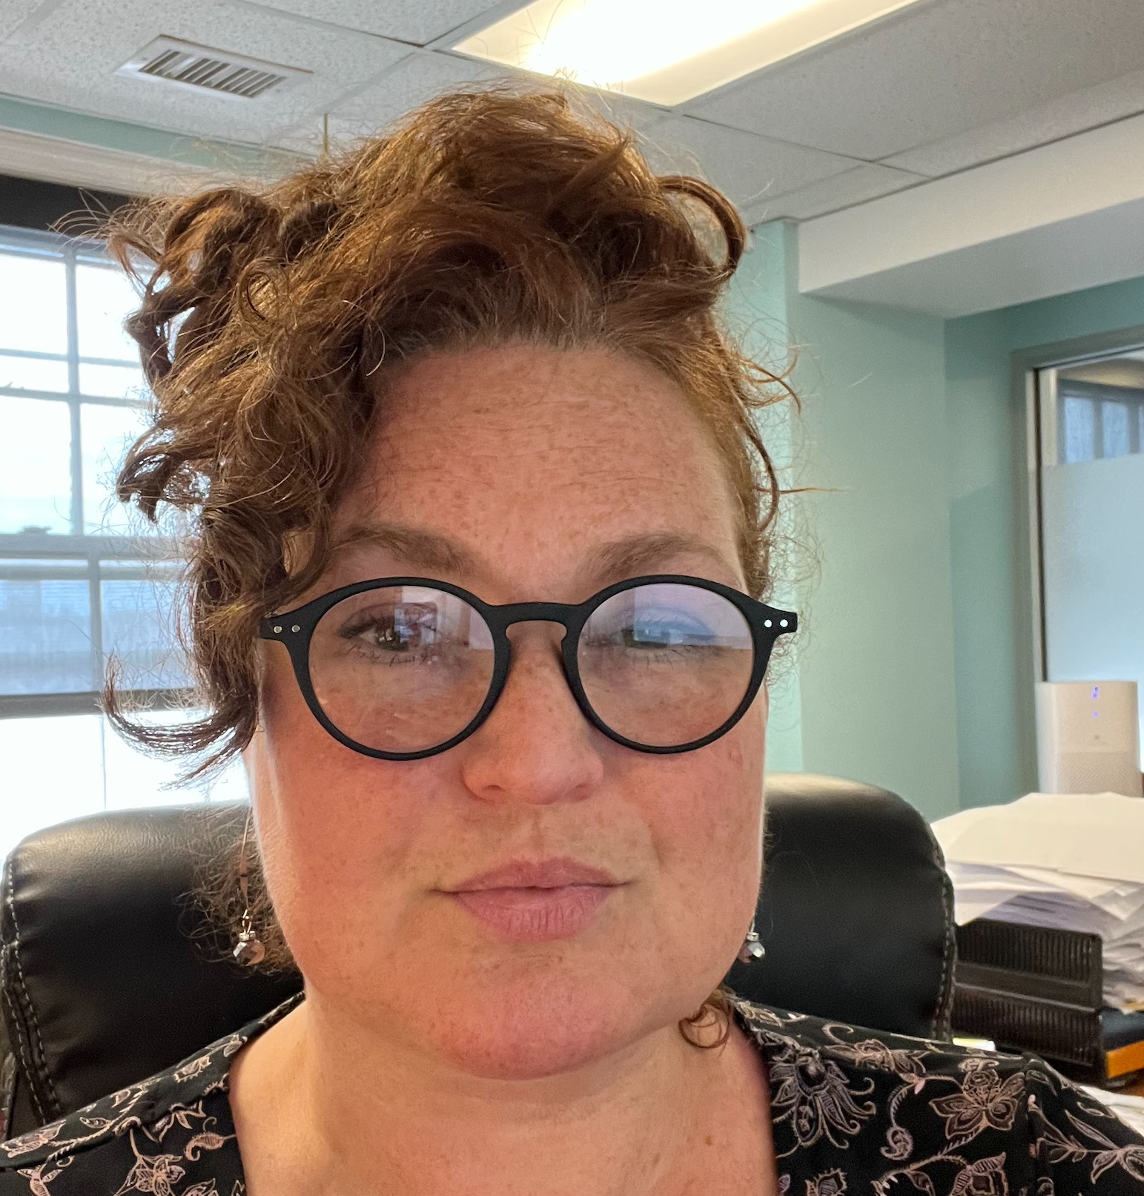
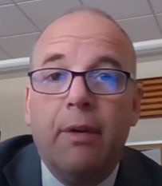
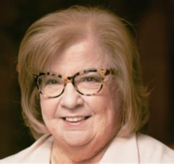
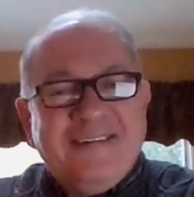
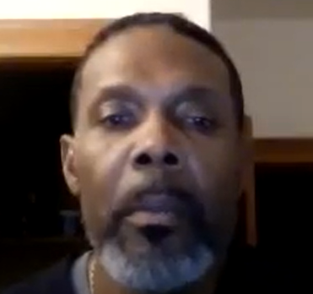
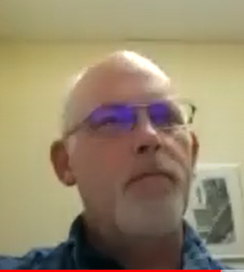
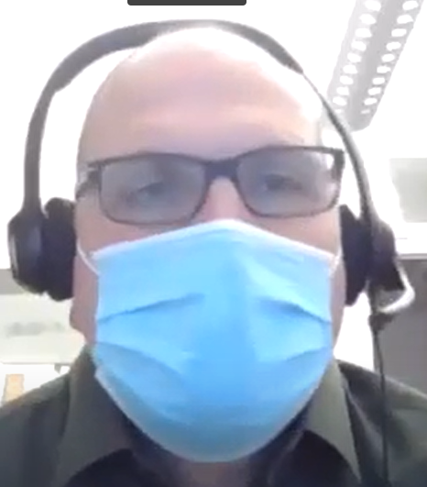
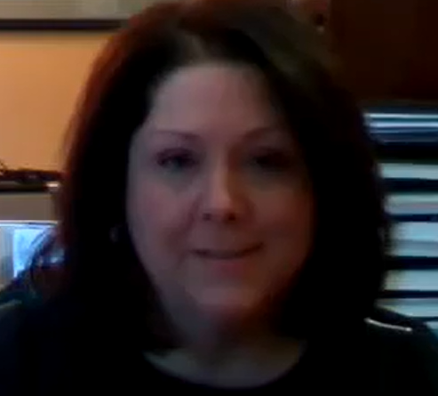
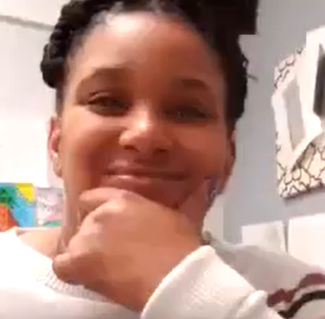
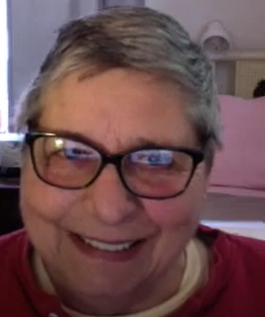
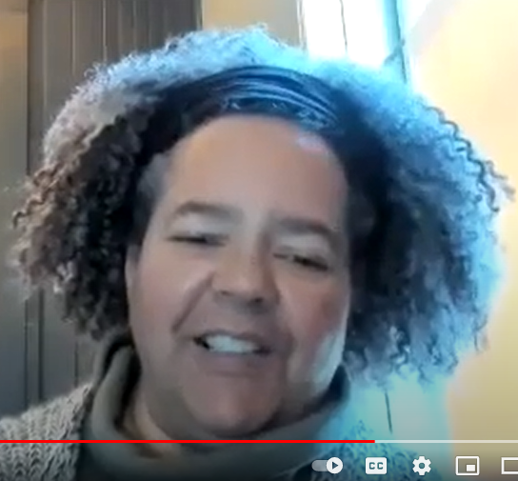
TROY COMMUNITY LAND BANK 2021 BOARD OF DIRECTORS
The TCLB By Laws require eleven (11) Board Members appointed by City stakeholders.
Four (4) Members are appointed by the Mayor
Heather King, Chair,
Brian Barker, Secretary
Krystina Marable, member
Elbert Watson, Treasurer
Four (4) members are appointed by the City Council
John Cubit, Member
Jeanette Nicholson, member
Andrew Cooper, member
Patricia Reilly, member
Two (2) Members are appointed by their respective School District
John Carmello, member appointed by the Troy City School District
Vacant Position representing Lansingburgh School District
One (1) Member is elected by a majority vote of existing members
Suzanne Spellen, Member
Corporation Staff
Tony Tozzi –Executive Director
Corporation Counsel
Catherine Hedgeman
Heather King
John Carmello
Patricia Reilly
Tony Tozzi
Elbert Watson
John Cubit
Brian Barker
Kate Hedgeman
Krystina Marable
Suzanne Spellen
Andrew Cooper
Jeanette Nicholson

Slide 5
BOARD OF DIRECTORS
GENERAL MEETINGS 2021
All Board of Directors meetings are open to the public.
A calendar of meetings can be found on our website:
troycommunitylandbank.org
January 27: Heather King, Suzanne Spellen, Jeanette Nicholson, Krystina Marable, Patricia Reilly, Andrew Cooper, John Cubit, John Carmello, Elbert Watson
February 24: Heather King, Suzanne Spellen, Brian Barker, Jeanette Nicholson, Krystina Marable, Patricia Reilly, Andrew Cooper, John Cubit, John Carmello, Elbert Watson
March 3 Special Meeting: Heather King, John Carmello, Andrew Cooper, Jeanette Nicholson, Elbert Watson, Patricia Reilly, Suzanne Spellen, Kristina Marable, Brian Barker
March 31 Annual & Monthly Meeting: Heather King, Suzanne Spellen, Brian Barker, Jeanette Nicholson, Patricia Reilly, Andrew Cooper, John Cubit, John Carmello, Elbert Watson
April 28: Heather King, Suzanne Spellen, Jeanette Nicholson, Patricia Reilly, Andrew Cooper, John Cubit, John Carmello, Elbert Watson
June 30: Heather King, Suzanne Spellen, Jeanette Nicholson, Krystina Marable, Andrew Cooper, John Cubit, John Carmello, Elbert Watson
September 22: Heather King, Suzanne Spellen, Brian Barker, Jeanette Nicholson, Krystina Marable, Andrew Cooper, John Cubit, John Carmello, Elbert Watson
October 29: Suzanne Spellen, Brian Barker, Jeanette Nicholson, Krystina Marable, Patricia Reilly, Andrew Cooper, John Cubit, John Carmello, Elbert Watson
November 10: Heather King, Suzanne Spellen, Brian Barker, Jeanette Nicholson, Krystina Marable, Andrew Cooper, John Cubit, John Carmello, Elbert Watson
December 22: Heather King, Suzanne Spellen, Brian Barker, Elbert Watson, Jeanette Nicholson, Andrew Cooper, John Cubit, Kristina Marable, Patricia Reilly

Slide 6
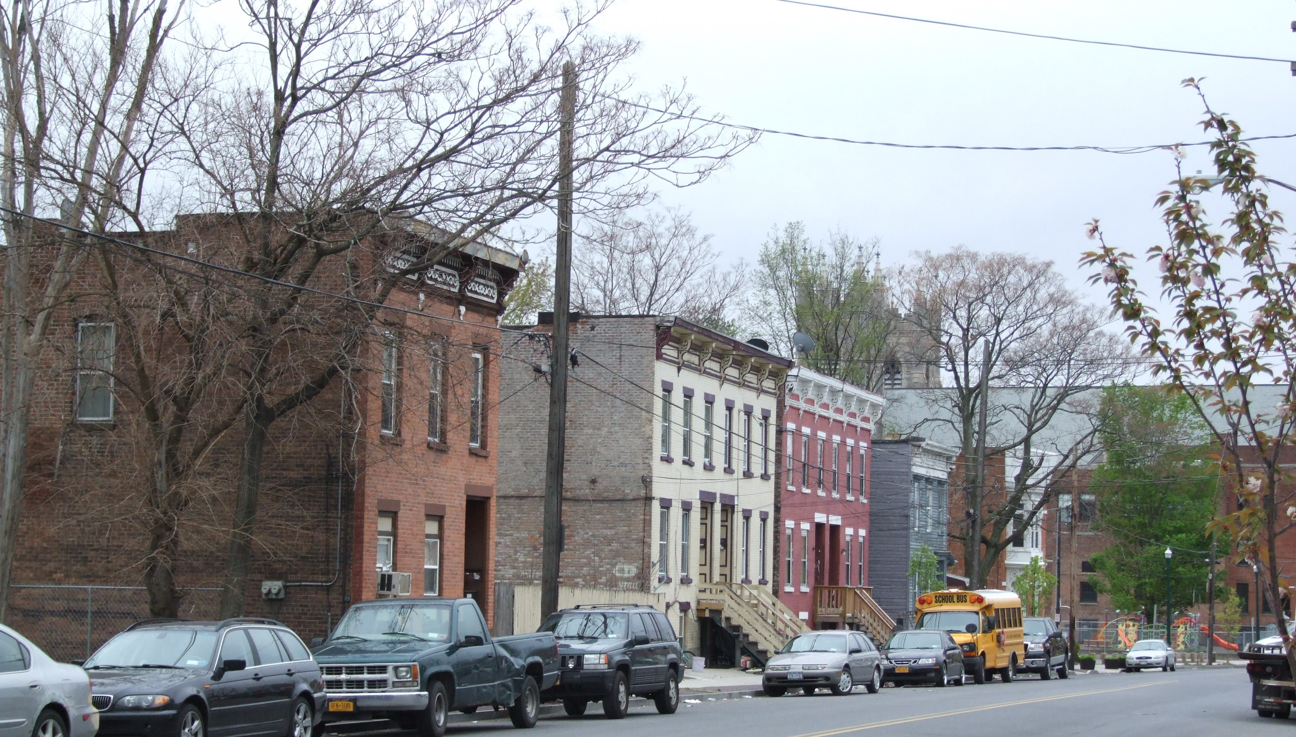
BOARD COMMITTEES
Executive Committee
Met: Jan 20, Feb 9, Mar 23, Apr 13, May 11, Jun 8,
July 13, Aug 10, Sep 14, Oct 19 and Dec 21
Heather King, Chair
Brian Barker, Member
Suzanne Spellen, Member
Elbert Watson, Member
Finance Committee
Met: Mar 22, Jun 22, Sep 21 and Oct 27
Elbert Watson, Chair
John Carmello, Member
John Cubit, Member
Marketing Committee
Met: Jan 13, Feb 5, Apr 27,
July 23 and Sep 27
Suzanne Spellen, Chair
Andrew Cooper, Member
Jeanette Nicholson, Member
Acquisition-Disposition Committee
Met: Jan 20, Feb 9, Mar 23, Apr 13, May 11, Jun 8,
June 11 (Special Meeting) Jul 13, Aug 10, Sep 14,
Oct 19, Nov 16 and Dec 21
Brian Barker, Chair
Heather King, Member
Jeanette Nicholson, Member
Elbert Watson, Member
Governance Committee
Heather King, Chair
John Carmello, Member
Audit Committee
Heather King, Member
Andrew Cooper, Member
Hiring Committee
Andrew Cooper, Member
Heather King, Member
Suzanne Spellen, Member

Slide 7
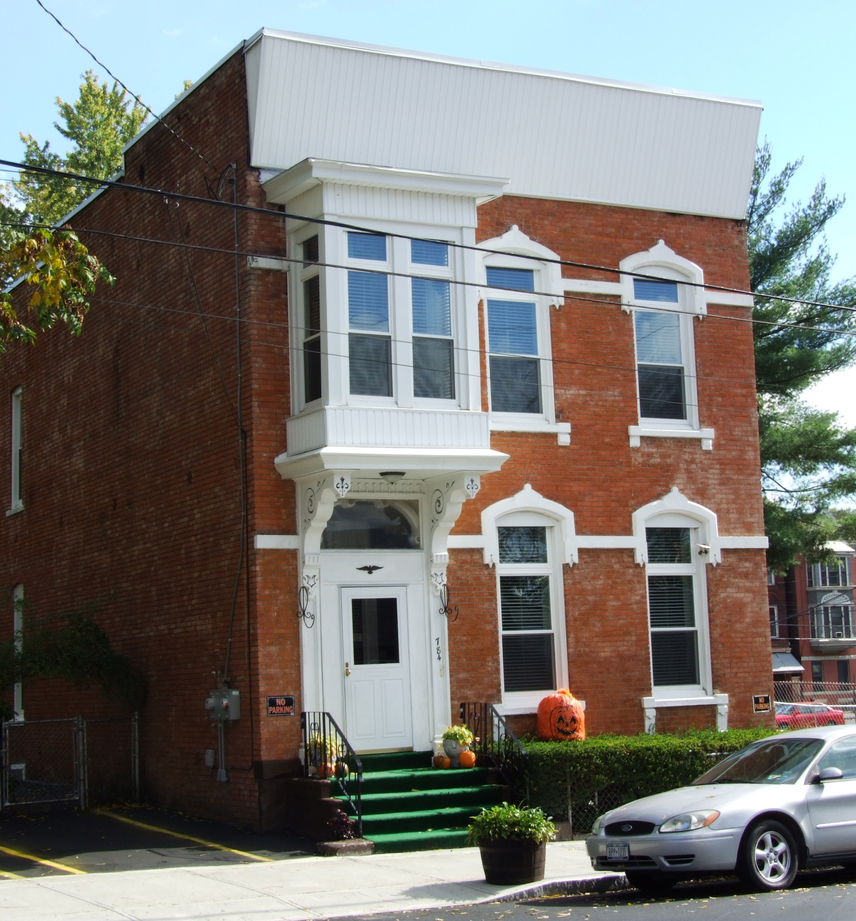
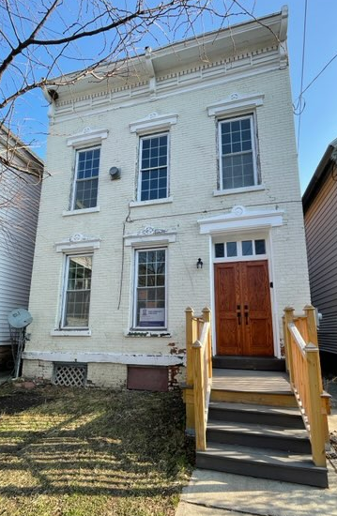
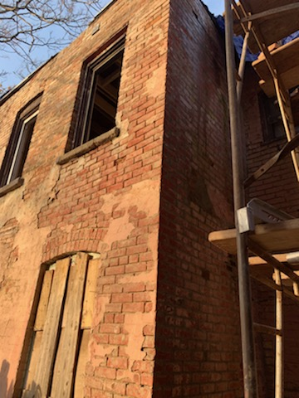
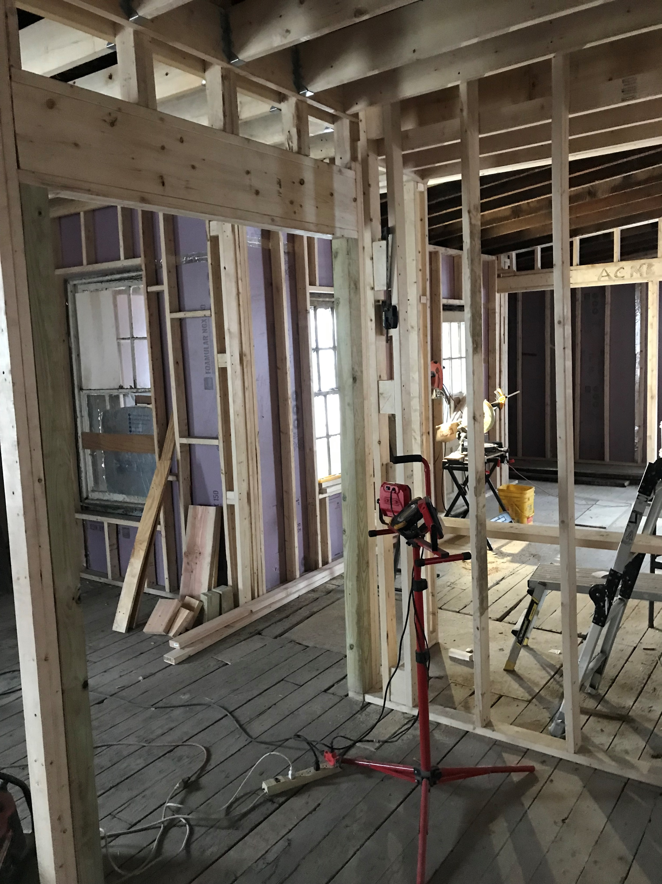
2021 Accomplishments
Developed and provided outreach and education webinars to potential developers and buyers
Continued forward with rehabilitation projects
Reclaimed properties that were not moving forward
Joined forces with the City, Habitat for Humanity and Troy Housing Authority to create a North Central Redevelopment and Renovation Plan
Completed significant predevelopment work for a Legacy Cities grant application to NYS for 9 new homeowner buildings in 2022

Slide 8
Community Liaison Berta Simpson provided outreach and education
Outreach and education was identified in prior years as necessary for successful ownership and rehabilitation of for sale Land Bank properties. To address these needs during a pandemic, Berta and TCLB Counsel Kate Hedgeman created webinars for potential buyers and developers entitled
“Walking through the Troy Community Land Bank Application Process”
“The Troy Community Land Bank Enforcement Process”

Slide 9
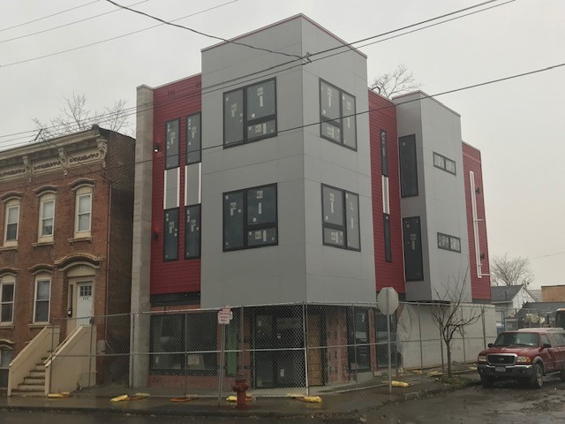
Success – an example of strategic pivot
Lemons To Lemonade !
791 River Street Then and Now

Slide 10
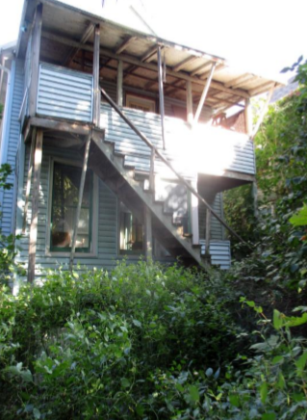
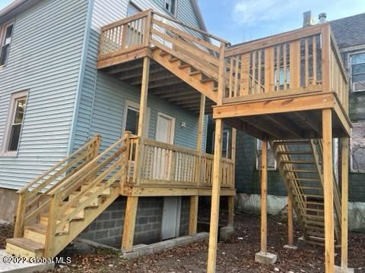
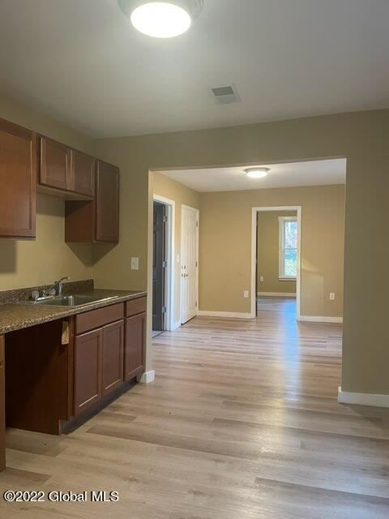
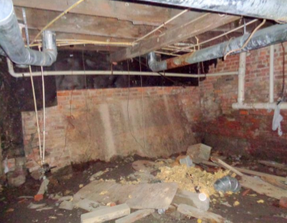
11 Winnie Street
Before and After

Slide 11
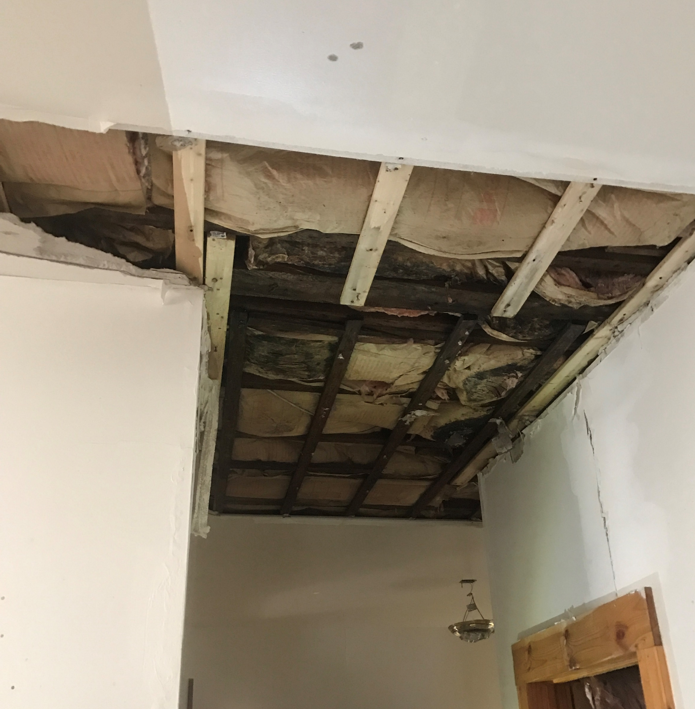
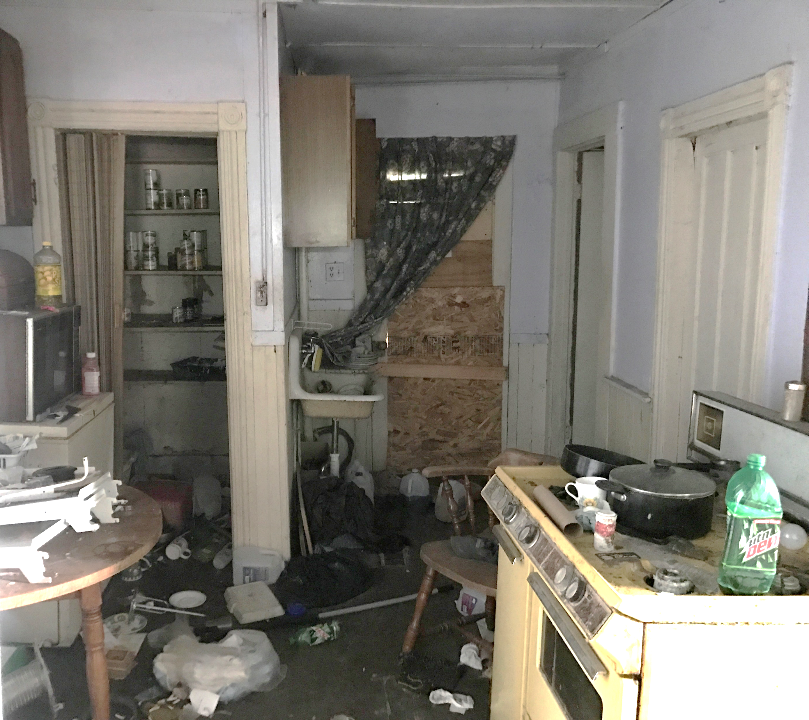
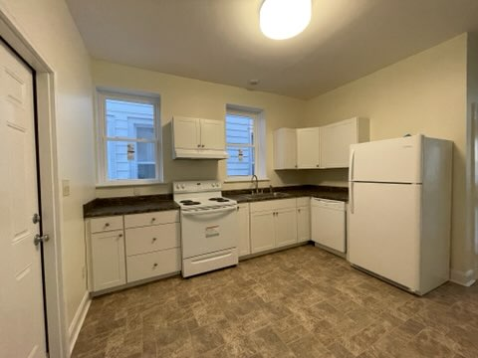
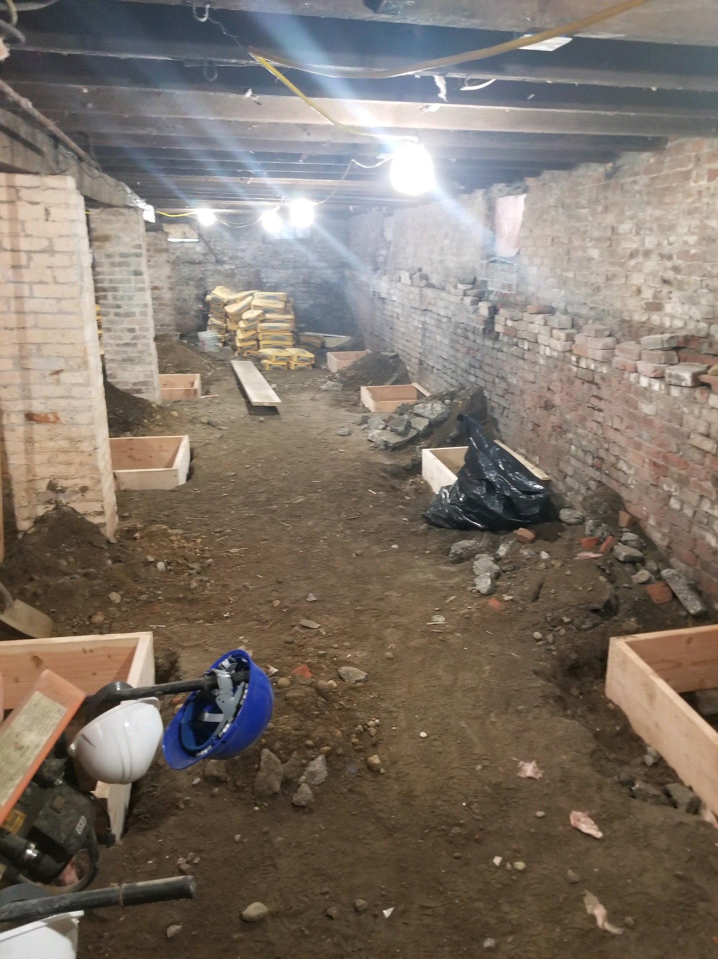
54 Fifth Avenue Before and After

Slide 12
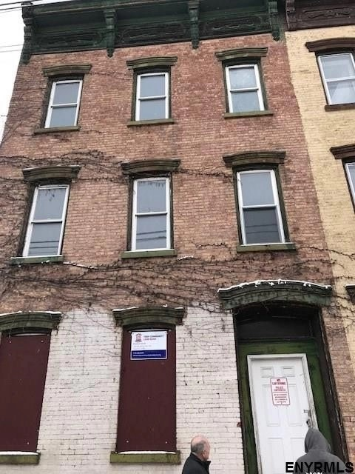
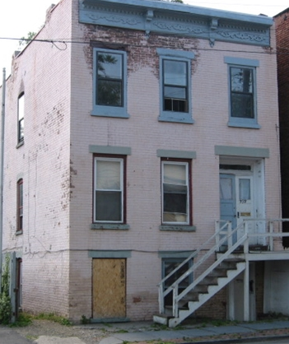
Reclaimed Properties - Our Commitment to Neighborhood Revitalization
Reclaimed and repurposed buildings
located 3209-3211 Seventh Ave and 834 River Street for homeowner projects in 2022
Reclaimed building at 785 River Street will be demolished in 2022, lot for sale

Slide 13
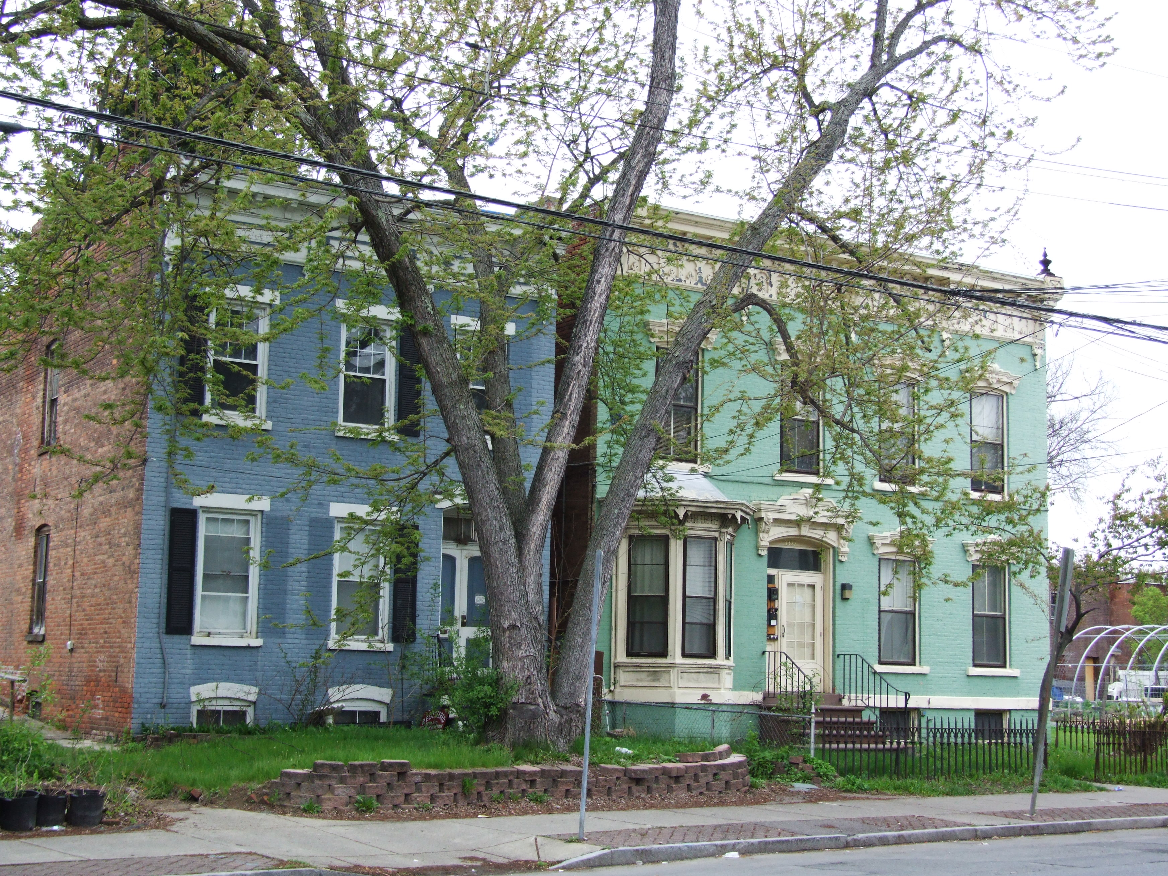
Collaboration is the key to successful neighborhood revitalization
This building, to the left, 3325 Sixth Avenue was saved from demolition by the tenacity of neighbors and collaboration of many stakeholders in our community working together

Slide 14
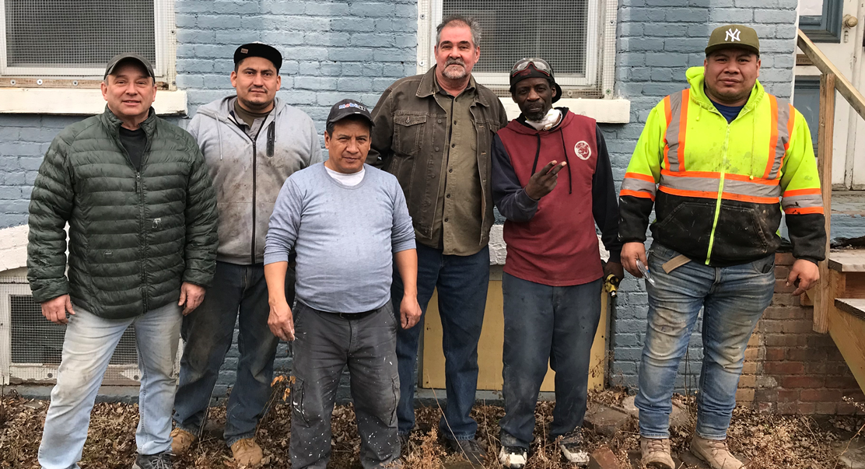
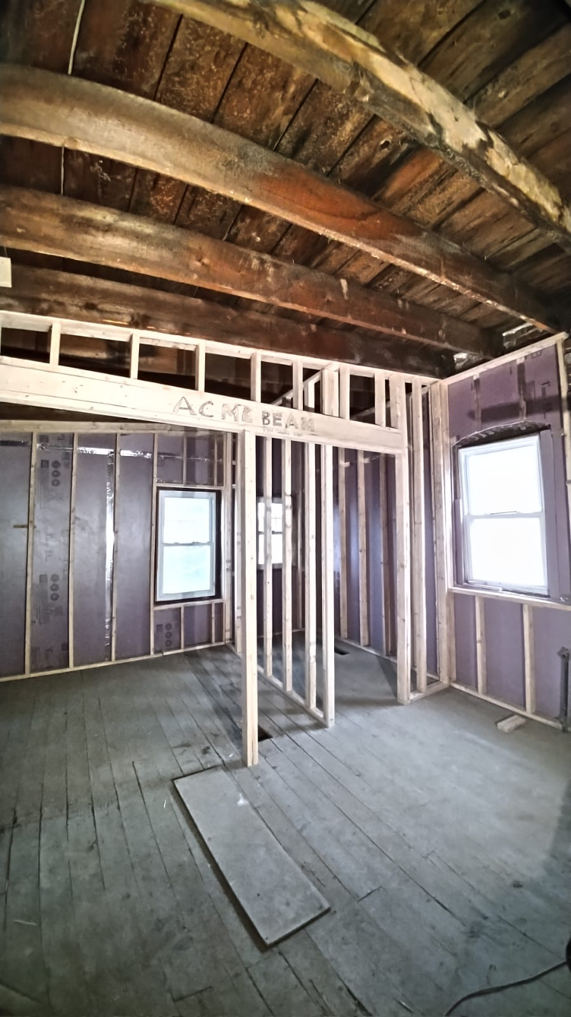
The collaboration went even further: Newly formed RPI Urban Studio assisted with architectural work & neighborhood workforce is completing construction.
3325 Sixth Avenue

Slide 15
Goals for 2022
Sell completed buildings to qualified homeowners
Sell vacant land (6 lots – 1 post demo) to Habitat for Humanity of the Capital District scheduled for new construction projects
Sell 3 vacant lots and 1 building to Troy Housing Authority for Fallon redevelopment project
Convert the 5 units at 809 River Street to 3 units and sell to qualified owner occupant
Complete clean out work at 32 Glen Avenue and sell to homeowner
Complete the Legacy Access application, get award from New York State and sell bundle of sites

Slide 16
Troy’s North Central Redevelopment and Renovation Plan
Each red dot represents a renovated building (Legacy ACCESS) or new construction (Habitat for Humanity) homeowner in North Central

Slide 17
Legacy Cities ACCESS Program
NYS Homes & Community Renewal in partnership with the Community Preservation Corporation, has a grant offering specifically for Land Banks in New York State when the land bank partners with a BIPOC (Black, Indigenous and People of Color) developer.
Land Banks can be awarded up to $95,000 per unit in subsidy
The developer must sell to homebuyers who must live there
The buildings must be in reasonably close proximity

Slide 18
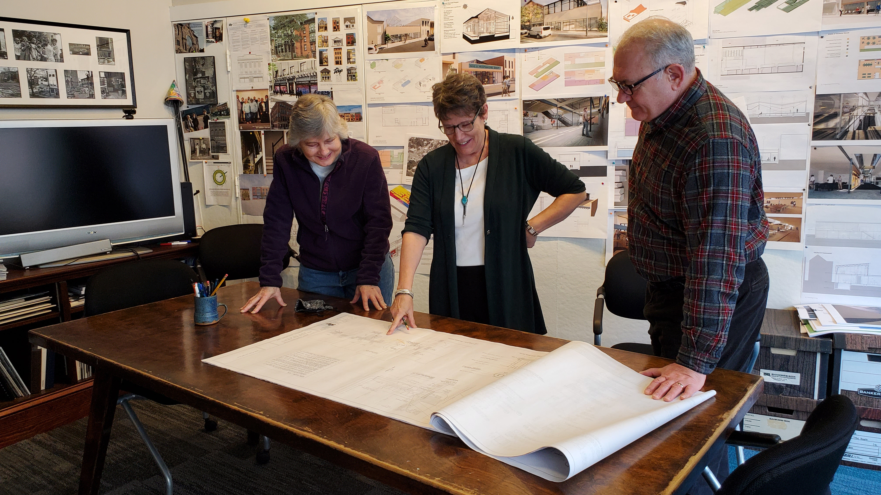
Significant Predevelopment work has been completed for the Legacy ACCESS grant application to NYS
Completed in 2021
Site Control of the 9 identified sites in the North Central Redevelopment Plan
Conducted outreach for BIPOC (Black, Indigenous, People of Color) developers, and selected a local developer through RFQ process
Completed existing conditions drawings for all buildings

Slide 19
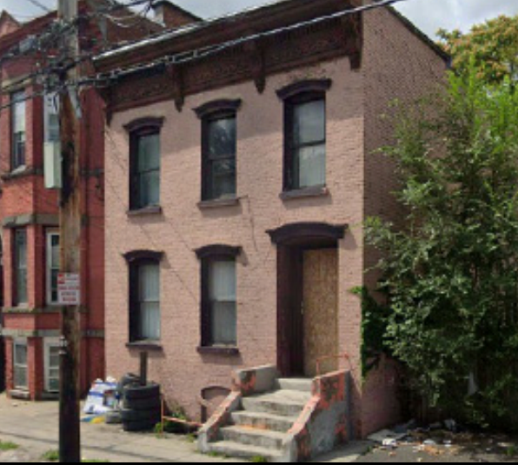
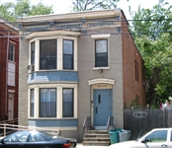
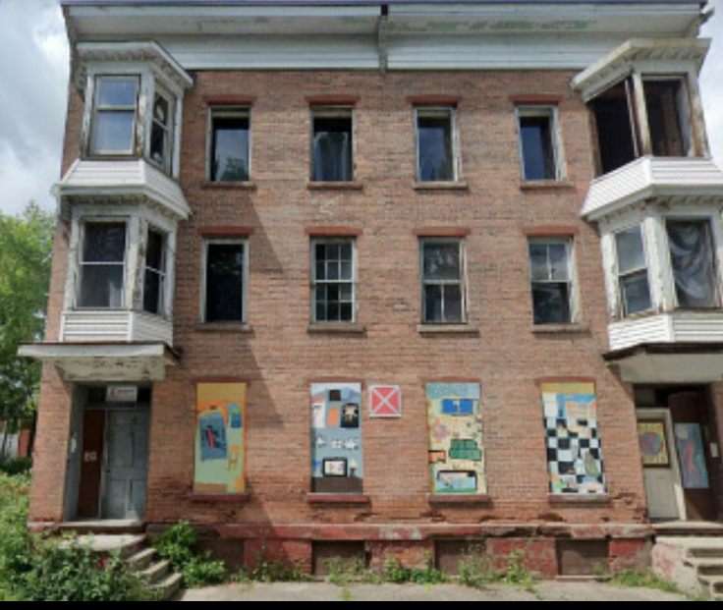
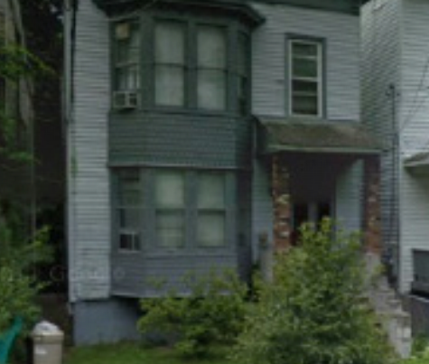
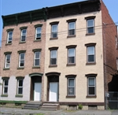
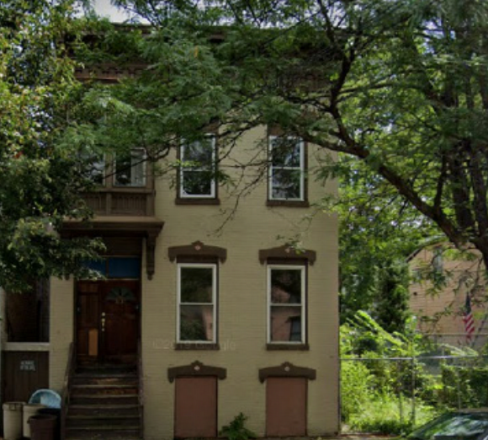
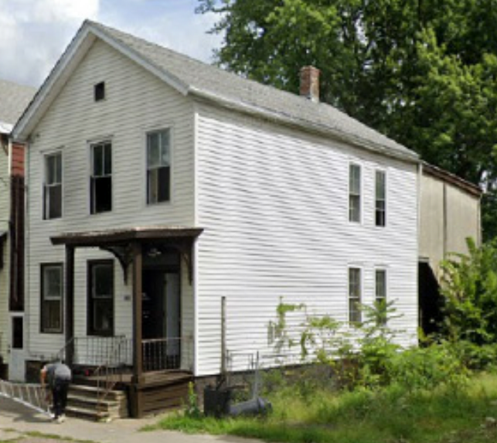
The Bundle of Sites Assembled for a NYS Legacy ACCESS grant application
3229 Sixth Ave
3215 Sixth Ave
3209-3211 Seventh Ave
17 Park Ave
834-836 River St
3230 Sixth Ave
3440 Sixth Ave

Slide 20
Troy, NY - based business specializing in Construction Management, General Contracting, Property Management, Real Estate & Community Development
Owned by partners David Downer and Emily Streeter
NYS MBE Certified
Number of Employees: 7-10
4 Office Staff, 3-6 On Site Staff

Slide 21
ACCOMPLISHED TO DATE
# 59 Properties (including vacant lots) acquired through donation, City In Rem or private acquisitions
# 17 Buildings sold for rehab
# 13 Completed renovations
# 11 Building stabilized
# 22 Buildings demolished
# 4 New construction homes

Slide 22
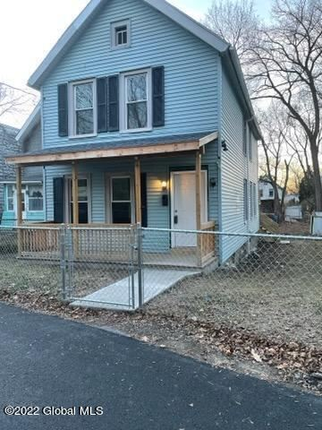
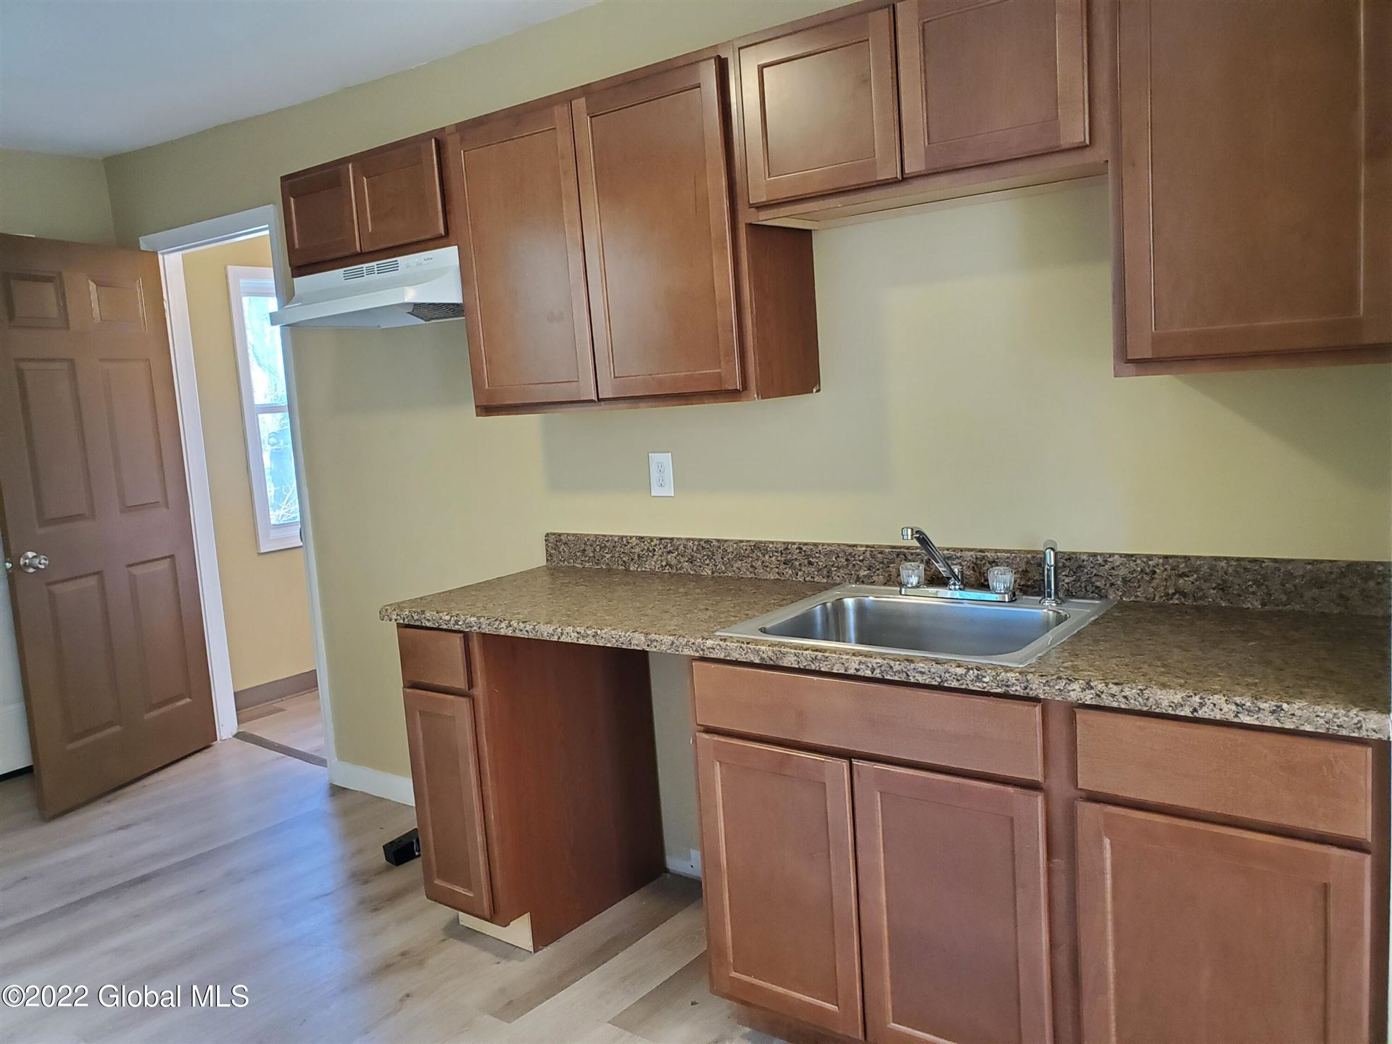
What’s next for the Troy Community Land Bank
Closing Remarks
Projected sales of market ready sites within the next six months will provide much needed cash and ability to pay off debt.
Additional grant opportunities allow us to facilitate the rehabilitation of 9 buildings for homeowners without being the developer.

Slide 23
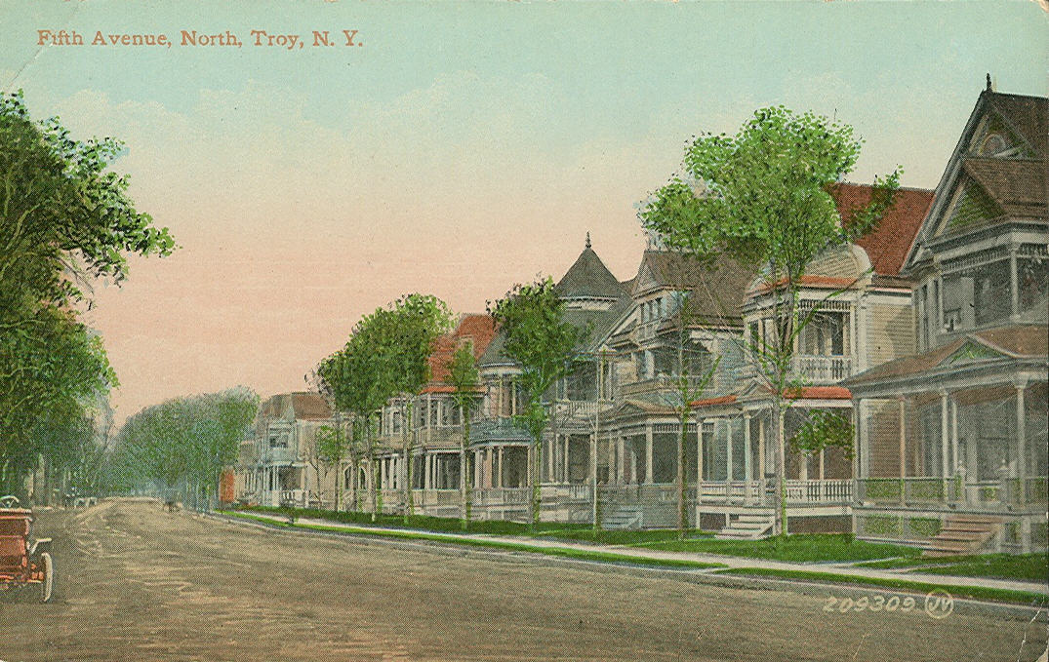
Thank you!
Can I answer any questions?
Tony Tozzi
Executive Director

